Slide 1
Identity Portal Forms
David Franco
August 2018

Slide 2
Agenda
What are forms in identity portal?
1
Where do we see forms in identity Portal?
2
Form properties types and options
3
Handlers and API / prop context
4
Plugins and service actions
5
Questions
6

Slide 3
What Are Forms?
The heart of requests in Identity Portal

Slide 4
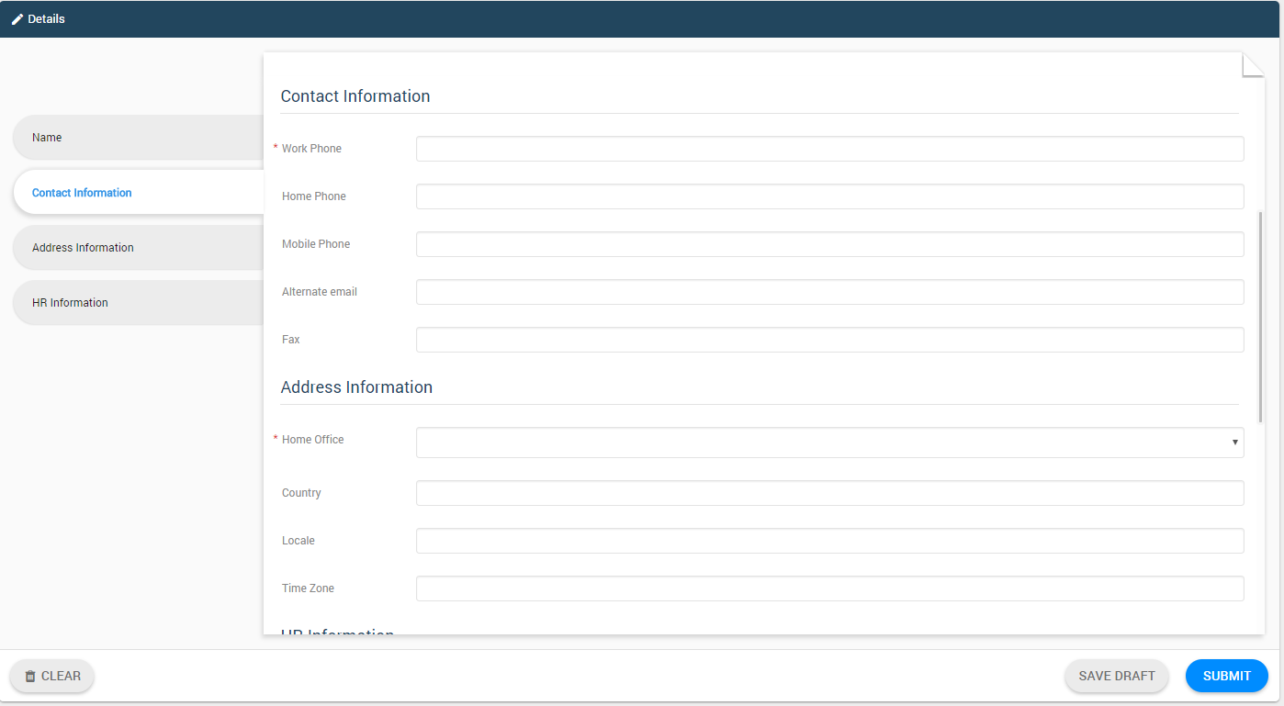
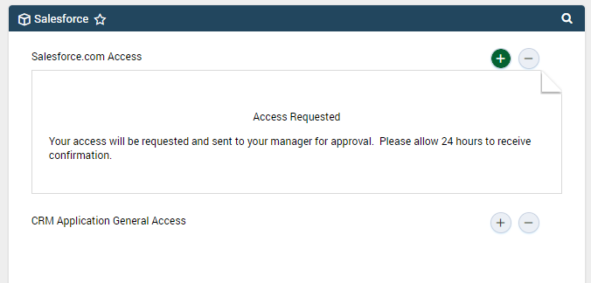
Forms are what the end users see when they submit requests in Identity Portal

Slide 5
What Are Forms? Submitting information to the backend system
Forms encapsulate the tasks that are executed in the backend system
Form properties can be mapped to users attributes
Contain various types of data or remain empty so they just trigger tasks
Include the information the user submits in requests and save it for auditing
Expose existing information for viewing

Slide 6
Where Do We See Forms in IDP?
The forms are everywhere, even now in this very room

Slide 7
Where Do We See Forms? Almost everywhere
Forms are configured in the Identity Portal Admin UI under the Elements tab
The end users use forms when submitting an access request or a module action, e.g. Create User, Modify Group, etc.
The information submitted in the request via the form will be visible in My Requests screen and also in Tasks screen when an approval is triggered
User can save a Draft of the request and its form(s)

Slide 8
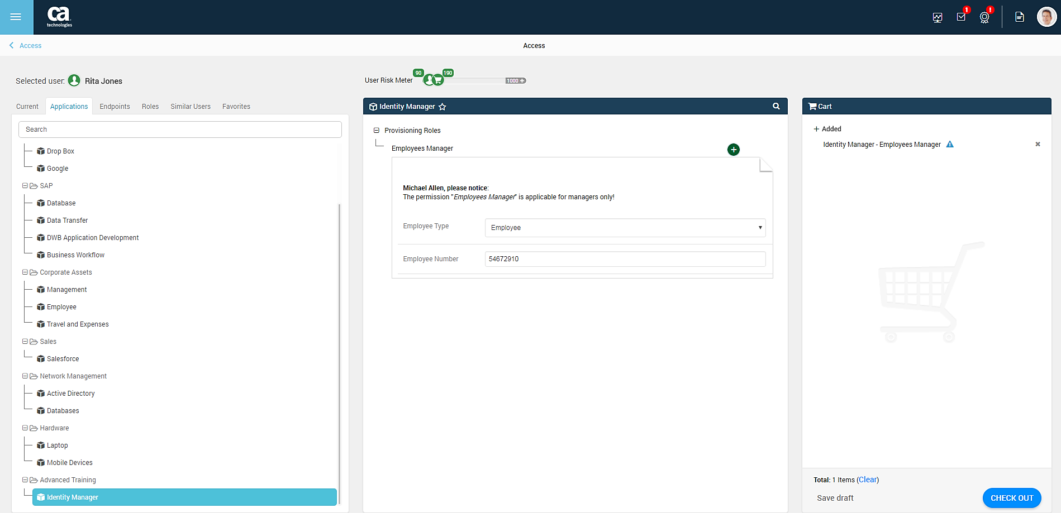
Where Do We See Forms? Access Request

Slide 9
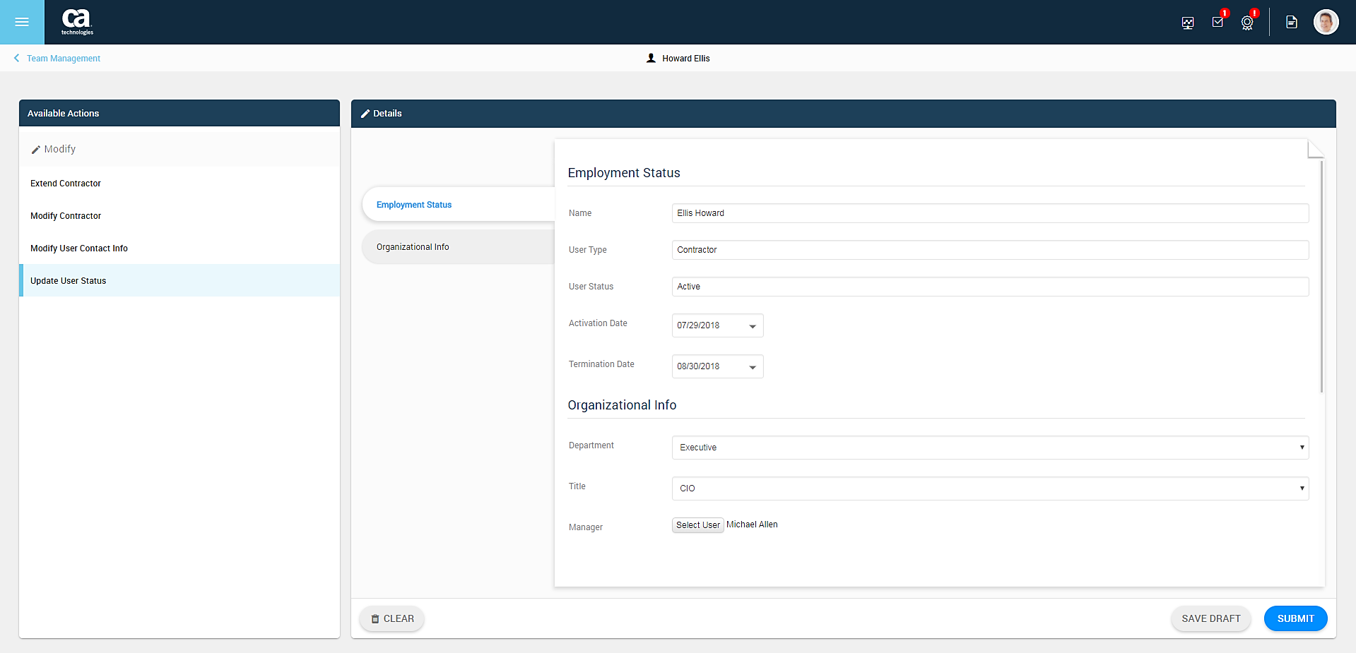
Where Do We See Forms? Module Action

Slide 10
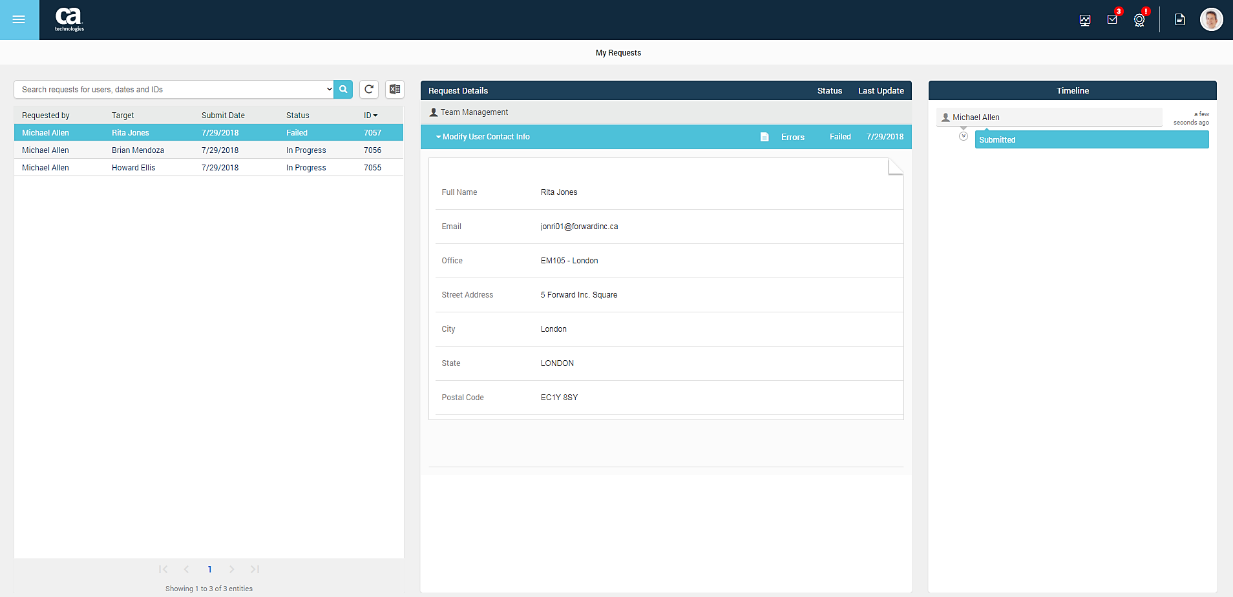
Where Do We See Forms? My Requests

Slide 11
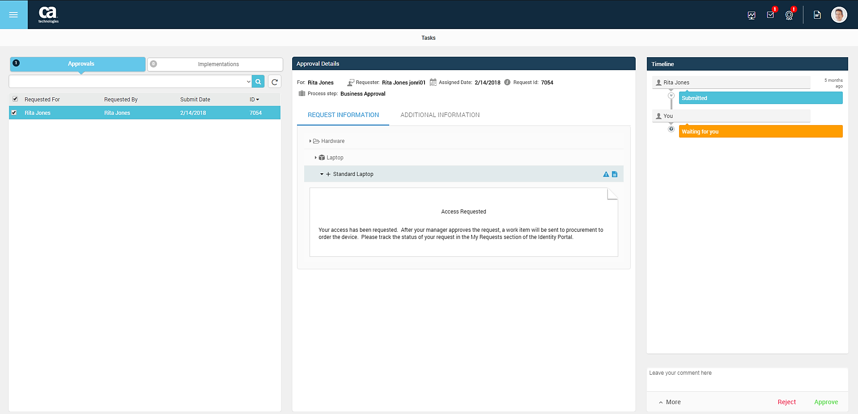
Where Do We See Forms? Approval Tasks – Request Information

Slide 12
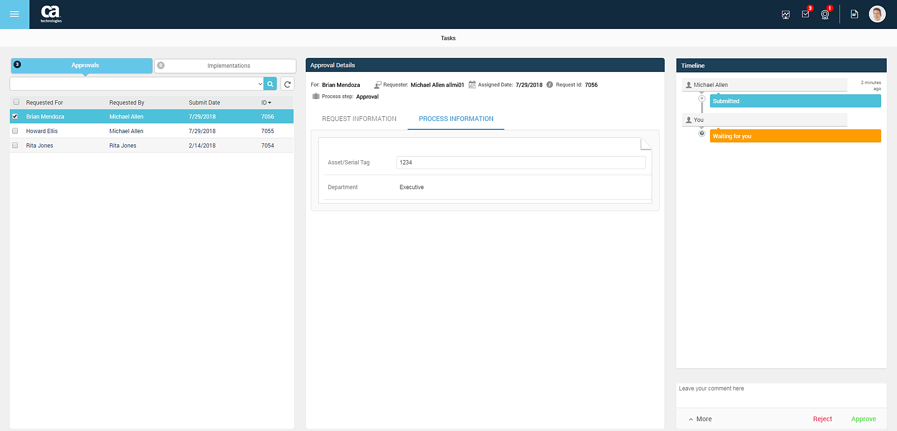
Where Do We See Forms? Approval Tasks – Process Information
The form in the Process Information tab is “alive”, unlike the form displayed in the Request Information tab which is not editable.

Slide 13
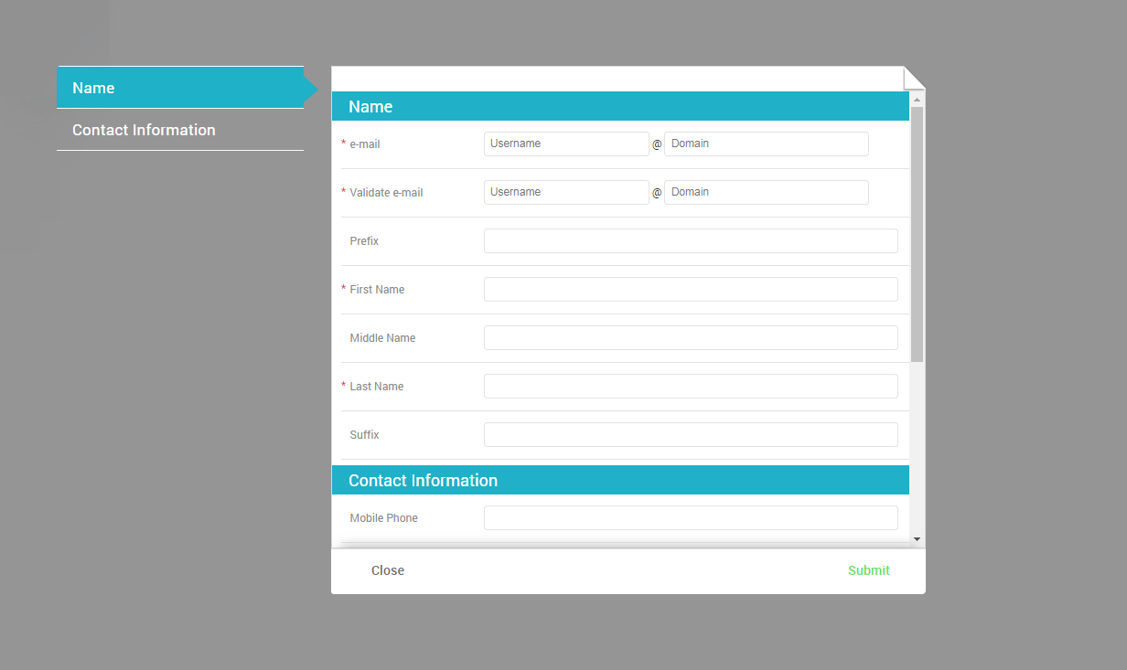
Where Do We See Forms? Self Registration

Slide 14
Form Properties, Types and Options
Different types, different capabilities

Slide 15
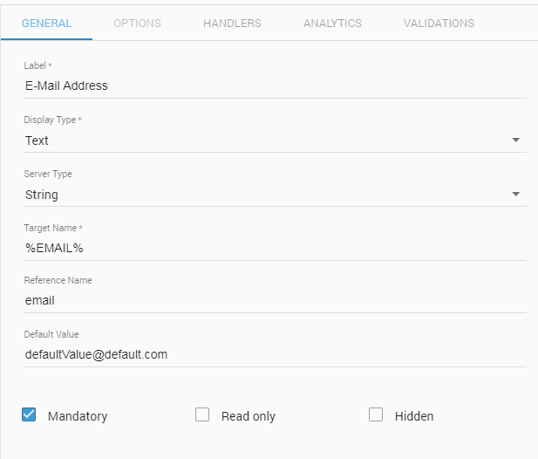

Form Properties, Types and Options Property General Configuration
Label and Reference Name
The property’s Label is its display name. Reference Name is its inner name that lives in the form context

Slide 16

Form Properties, Types and Options Property General Configuration
Target Name
The name of backend attribute the property is mapped to

Slide 17

Form Properties, Types and Options Property General Configuration
Default Value
Whenever the property has no other value, the default value is submitted

Slide 18

Form Properties, Types and Options Property General Configuration
Display Options
Mandatory, Read Only or Hidden

Slide 19
Form Properties, Types and Options Display types
Define the behavior and display of the property
Single-value vs Multi-value
Different property types have different options and validations capabilities
Few property types enforce a specific server type (e.g. Message is always Internal)

Slide 20
Form Properties, Types and Options Server types
Define the server logic of the property
Default server type is String – the value will be submitted as is
The Hidden server type is special – it allows to submit values that will be generated on runtime by the server
Internal property is not submitted to the backend system

Slide 21
Handlers and API / Prop Context
Doing some magic behind the scenes

Slide 22

Handlers and API / Prop Context Handlers
The form handlers enable you to use JavaScript code to control the behavior of the form
Each property has three handlers: Initialization, Change and Validation
All handlers are injected with the ‘api’ context and ‘prop’ context

Slide 23
Handlers and API / Prop Context Handlers
Initialization handler is executed only once, when the form is loaded
Change handler will be executed every time the value of the property changes
Validation handler is executed when the form is submitted

Slide 24

Handlers and API / Prop Context API Context
The ‘api’ context exposes several methods that are useful when developing the handlers code logic
These methods allow:
Retrieving information regarding the request context in which the form is loaded
Executing Plugins and Service Actions
Retrieving the locale of the system
Reading data from other properties on the form and manipulate them

Slide 25
Handlers and API / Prop Context API Context
api.getProp – fetches another property on the same form
api.getReuqester – returns the User object of the logged in user
api.getSubject – returns an array of User / Group that are the subject of this request
api.getEntitlement – returns the permission name which this form is associated with
api.getLocale – returns the current Locale of Identity Portal
api.prompt – displays a message dialog
api.server – calls a Plugin
api.service – calls a Service Action
https://docops.ca.com/display/CIS142/Api+Context

Slide 26

Handlers and API / Prop Context Prop Context
Each handler associated with the property has a prop context
The prop context enables manipulating the property itself
The “api.getProp()” method from the ‘api’ context returns prop context of another form property
Properties can be referred by using their Reference Name

Slide 27
Handlers and API / Prop Context Prop Context
Attributes that change the property’s configuration:
prop.label
prop.mandatory, prop.readOnly, prop.hidden
Attributes that change the property’s value and state:
prop.value / prop.values
prop.options
prop.message
prop.errors

Slide 28
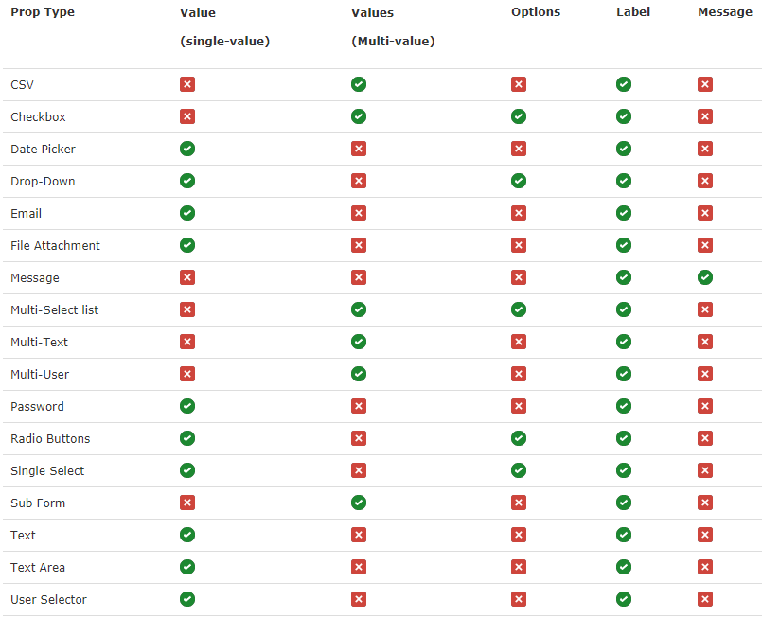
Handlers and API / Prop Context Prop Context
https://docops.ca.com/display/CIS142/Prop+Context

Slide 29

Hands-On Workshop
Lab 1 – Handlers, API and Prop Context

Slide 30
Plugins and Service Actions
Asynchronous additional assistance from the backend

Slide 31

Plugins and Service Actions Plugins
Java or RhinoJS (server-side JavaScript) code executed on server side
Triggered by forms handlers
The FORM tab of the plugin configuration screen specifies the forms in which the plugin can be used
Enrich the business logic of a form:
Fetching available form prop values from external database or other resources
Performing complex validation logic

Slide 32
Plugins and Service Actions Plugins
Plugin calls are asynchronous, they generate HTTP requests
Use “api.server([<plugin_name>, arg1, arg2 …])” method to call a plugin:
The method receives an array as its single argument
First item in the array should be the name of the plugin
The rest of the items in the array are arguments that can be passed to the plugin code from within the form context
Append a ‘.then()’ function to the ‘api.server’ call to handle the response.

Slide 33
Plugins and Service Actions Plugins
‘api.server’ method returns a Promise – when the response is ready, its content will be accessible in the code inside the ‘then()’ function.
The response is an object of the following form: { “returnValue”: <the-return-value-from-the-plugin> }
Remember that Validation handlers should return a boolean value. When using plugin in a Validation handler, avoid asynchronous problems by using the ‘return’ keyword, returning the call of ‘api.server’.

Slide 34

Plugins and Service Actions Plugins – RhinoJS (Javascript)
RhinoJS Plugin is a server-side JavaScript code that is written in the plugin configuration
It allows you to import Java classes and use them in the plugin code
Code is written in the plugin configuration screen
Changes in the code of the plugin will be effected immediately
The JavaScript function must have the same name as the plugin name

Slide 35

Plugins and Service Actions Plugins – Java
Java class(es) deployed on the server in the Plugins directory.
Configure the path of the Plugins directory in ‘General Configuration’ screen
The Java plugins are loaded on the server startup
Use the URL <Identity_Portal_url>/sigma/rest/admin/plugins/refresh to load new plugins without restarting the server
In cluster configuration, the plugin classes should be deployed on all nodes

Slide 36
Plugins and Service Actions Plugins – Java
The Java class plugin needs to extend the BasePlugin class
The class must have a function that will serve as the execution start point
This function must have the “@ExportedServerFunction” annotation
This function can return any type of object and receive any type of arguments in correspondence to the arguments passed to it by the form handler

Slide 37
Plugins and Service Actions Plugins – Java
Java plugin can have Initialization Parameters, which are key-value pairs defined in the INIT PARAMS tab of the plugin configuration
These parameters can be fetched in the code using the “getInitParamValues(String key)” function
Use the “initPlugin” method to perform initialization actions, it will be triggered every time the plugin is initiated

Slide 38
Hands-On Workshop
Lab 2 – Plugins

Slide 39
Plugins and Service Actions Service Actions
Service actions can be referred to as internal service tasks
They are very similar to module actions, but are not visible to the end user
Same as with module actions, a service action is linked to a from
The service action fetches the initialization data from the form it uses, which in turn retrieves information from the task it is linked to
The scoping of the service action is inherited from the admin task scoping

Slide 40
Plugins and Service Actions Service Actions
Instead of being triggered by the user, a service action is initiated by another form handler when using the ‘api.service’ method.
Thus, by using a service action you can initiate another task asynchronously in the backend and use the data it exposes
It is useful when there is a business logic in the backend system which you need to fetch its result into a form

Slide 41
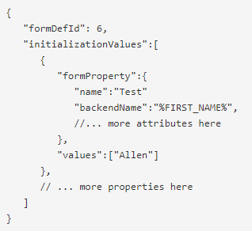
Plugins and Service Actions Service Actions
The ‘api.service’ is asynchronous and returns a Promise
The response contains all the properties that were defined in the service action form and their initialization values
The function signature is: “api.service('<service-action-name>', '<object id>', <init values>)”

Slide 42
Hands-On Workshop
Lab 3 – Service Actions

Slide 43
Questions
And hopefully also answers

Slide 44
David Franco
Sr Software Engineer
David.Franco@ca.com

Slide 45
Thank You.

